Slide 1
AZT Pharma K.B. LLC
COMPANY PRESENTATION

Slide 2
About us
The pharmaceutical company AZT PHARMA K.B. is a developer and manufacturer of antiretroviral drugs. A group of scientists headed by academician of RAS A.A. Kraevskiy discovered the active substance phosphazid and proved its effectiveness for the treatment and prevention of human immunodeficiency virus (HIV) infection. The discovery awarded the State Prize – “For developing a strategy for producing human immunodeficiency virus inhibitors and creating phosphazid - a new drug for treating people”.
In 1999, the original drug phosphazid under the trade name Nikavir® was registered. The drug is included in the List of Vital and Essential Drugs.
Today AZT PHARMA K.B. is the only manufacturer of the original Russian drug Nikavir® for the treatment of HIV infection. Production License No. 00201-LS as of April 09, 2018.
The production site is located in the Moscow Technological Park “STROGINO”*and it meets the standards of the organization of pharmaceutical production. All stages of the production process, including chemical synthesis of active substances are carried out in the Russian Federation.
* Technopark “STROGINO “was created by the Moscow Government with the support of the Ministry of Economic Development of Russia in 2007 and is the only technopark in Moscow that implements the full cycle of project support from the idea to the organization of production.

Slide 3
For 19 years, the company has been providing drugs to 93 subjects of the Russian Federation as part of the State Strategy of Counteraction to HIV Infection
The priority lines of development of the pharmaceutical company “AZT PHARMA K.B.” LLC are:
1
2
3
Development and production of original ARV drugs
(including combined drugs)
Work with new dosage forms for existing drugs
Study of promising molecules active against HIV infection
In 2018, a new combined drug Phosphaladine® based on phosphazid and lamivudine was registered. The development and all the necessary types of research were carried by the company with the involvement of State funding.
The drugs developed and manufactured by the company are characterized by high safety and effectiveness as compared to their competitors (NRTI group). In addition, Nikavir® and Phosphaladine® can be used (and are being used) for a number of patients who need special treatment, including people with co-infections.

Slide 4
Nikavir® tablets of 200 mg (PhAZT)
Children aged 3 to 18. Low level of cytotoxicity of the drug.
Pregnant women. The safest drug for the fetus capable of crossing the hematoplacental barrier.
Patients with combined pathology requiring a reduction in the standard dosage.
HIV infection with anemia, erythropenia and granulocytopenia;
HIV infection with cirrhosis;
HIV infection with kidney disease.
Postexposure prevention of professional contamination to HIV infection. To prevent the development of HIV among the medical staff.

Slide 5
Nikavir ® tablets of 400 mg (PhAZT)
Patients older than 50 or those with lipid and carbohydrate metabolism disorders, patients with a risk of cardiovascular disease, kidney disease and risk of osteoporosis;
Patients with neuro-cognitive disorders, who require ARVP that can penetrate the blood-brain barrier.
Women of childbearing age of 18-49, including those planning a pregnancy, since the drug belongs to the regimen with a high safety profile; women with HIV-associated anemia, unless anemia and/or granulocytopenia is ≥ I degree of toxicity.
Patients with intolerance or resistance to TDF, ABC, ZDV.

Slide 6
Phosphaladine® tablets (PhAZT 400 mg + 3TС 150 mg)
Combined drugs are a global trend for patient convenience that promotes better treatment adherence.
Naive patients with HIV infections leading an active lifestyle. In order to reduce the viral load as quickly as possible.
Patients with diseases of the cardiovascular system, metabolic disorders and neurocognitive disorders. In order to prevent complications in somatic pathology.
Patients with HIV and tuberculosis. In order to assist in the selection of anti-TB regimens.

Slide 7
New original nucleoside analog reverse-transcriptase inhibitor 6HP
AZT Pharma K.B. in cooperation with LLC Prolonged medication developed new original nucleoside analog reverse-transcriptase inhibitor 6HP. Preclinical and clinical studies (phase I,II) were conducted. The results prove 6HP as the best in NRTI class and it’s possible to create a low-toxic combined drug of a single daily application on 6HP basis: 6НР+FTC/3TC
It will beat for tolerability all of the known combined drugs of nucleoside bases – Combivir, Kivexa/Epzicom, Truvada and Descovy.
It can become a universal nucleoside base of ART regimens for different groups of patients (with anemia and neutropenia, renal failure, osteopenia, liver diseases, cardiovascular diseases, pregnant women, patients aged 50 and older, etc.)
AZT Phozphazid 6HP

Slide 8
Pharmacokinetics
The concentration of AZT in blood plasma after oral administration of zidovudine (3 x 200 mg), phosphazid (2 x 400 mg), 6HP (1000 mg)
The significant difference in peak concentrations of AZT explains lower toxicity of Phosphazid. Over a 15-year period of using Phosphazid, not a single case of drug resistance was recorded.
6HP has even lower toxicity than Phospazid.

Slide 9
Competitive benchmarking analysis with NRTIs
HIV groups | Abacavir | Zidovudine | Tenofovir | Phosphazid | 6HP
Adult patients with hepatic lipidosis | not recommended | can be used (with caution) | not recommended | preferable | preferable
Adult patients with signs of suppression of blood formation (anemia, neutropenia) | can be used | not recommended | applicable | can be used (with caution) | can be used (with caution)
Adult patients with kidney failure (Fanconi syndrome) | can be used | can be used | not recommended | preferable | preferable
Adult patients with reduced bone density | can be used | can be used | not recommended | preferable | preferable
Adult patients with myalgia | can be used | not recommended | applicable | n/a | n/a
Adult patients with viral hepatitis (HBV, HCV) | can be used (with caution) | not recommended (cannot be used with ribavirin) | can be used | preferable (can be used with ribavirin) | preferable (can be used with ribavirin)
Adult TB patients | can be used | can be used (with caution) | can be used | preferable | preferable
Pregnant women | can be used (with caution) | can be used | not recommended | preferable | preferable
Children aged 3 to 18 | can be used (with caution) | can be used | not recommended under 12 | preferable | preferable
Adult patients with central nervous system impairment | can be used | preferable | n/a | preferable | preferable

Slide 10
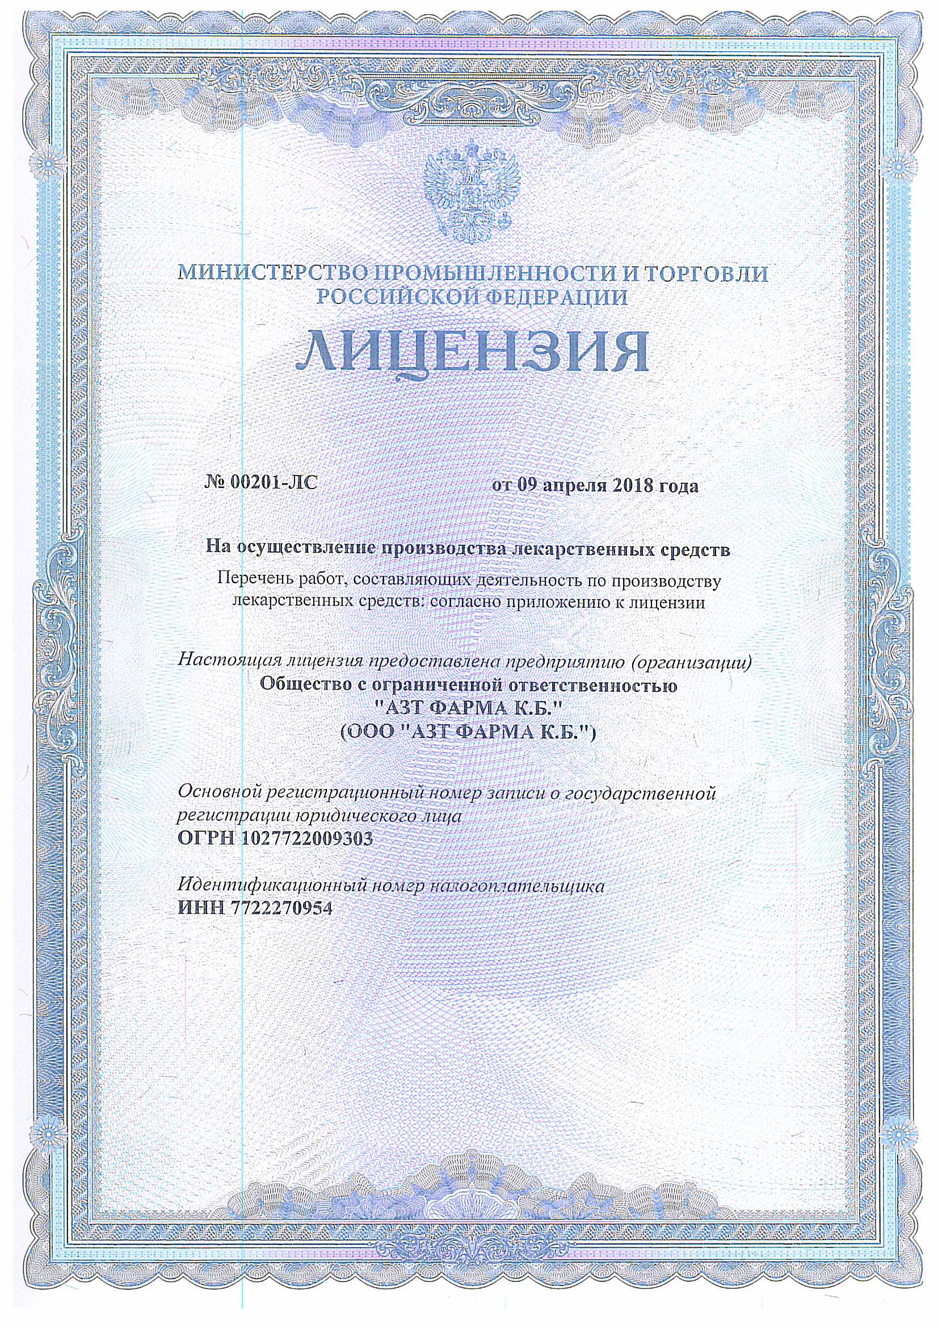
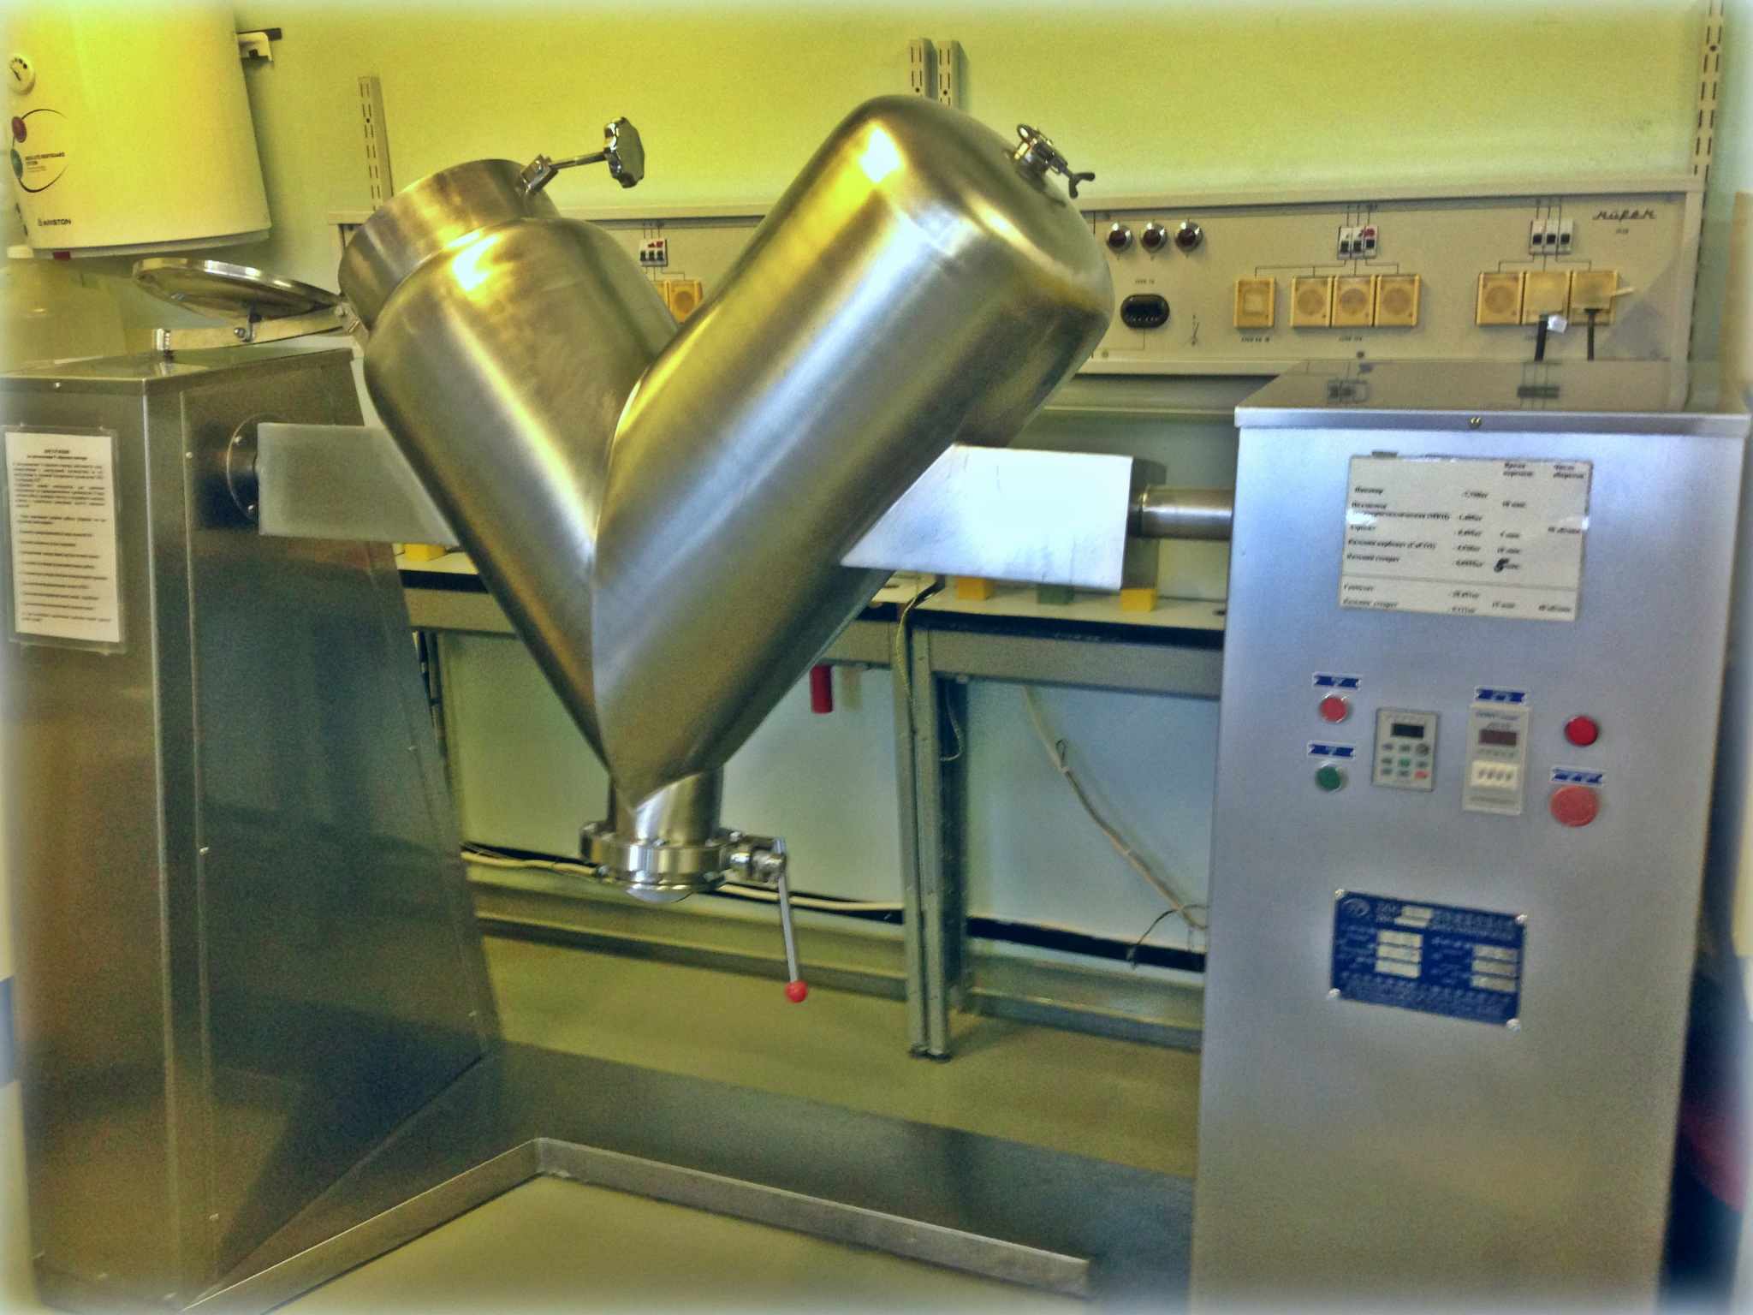
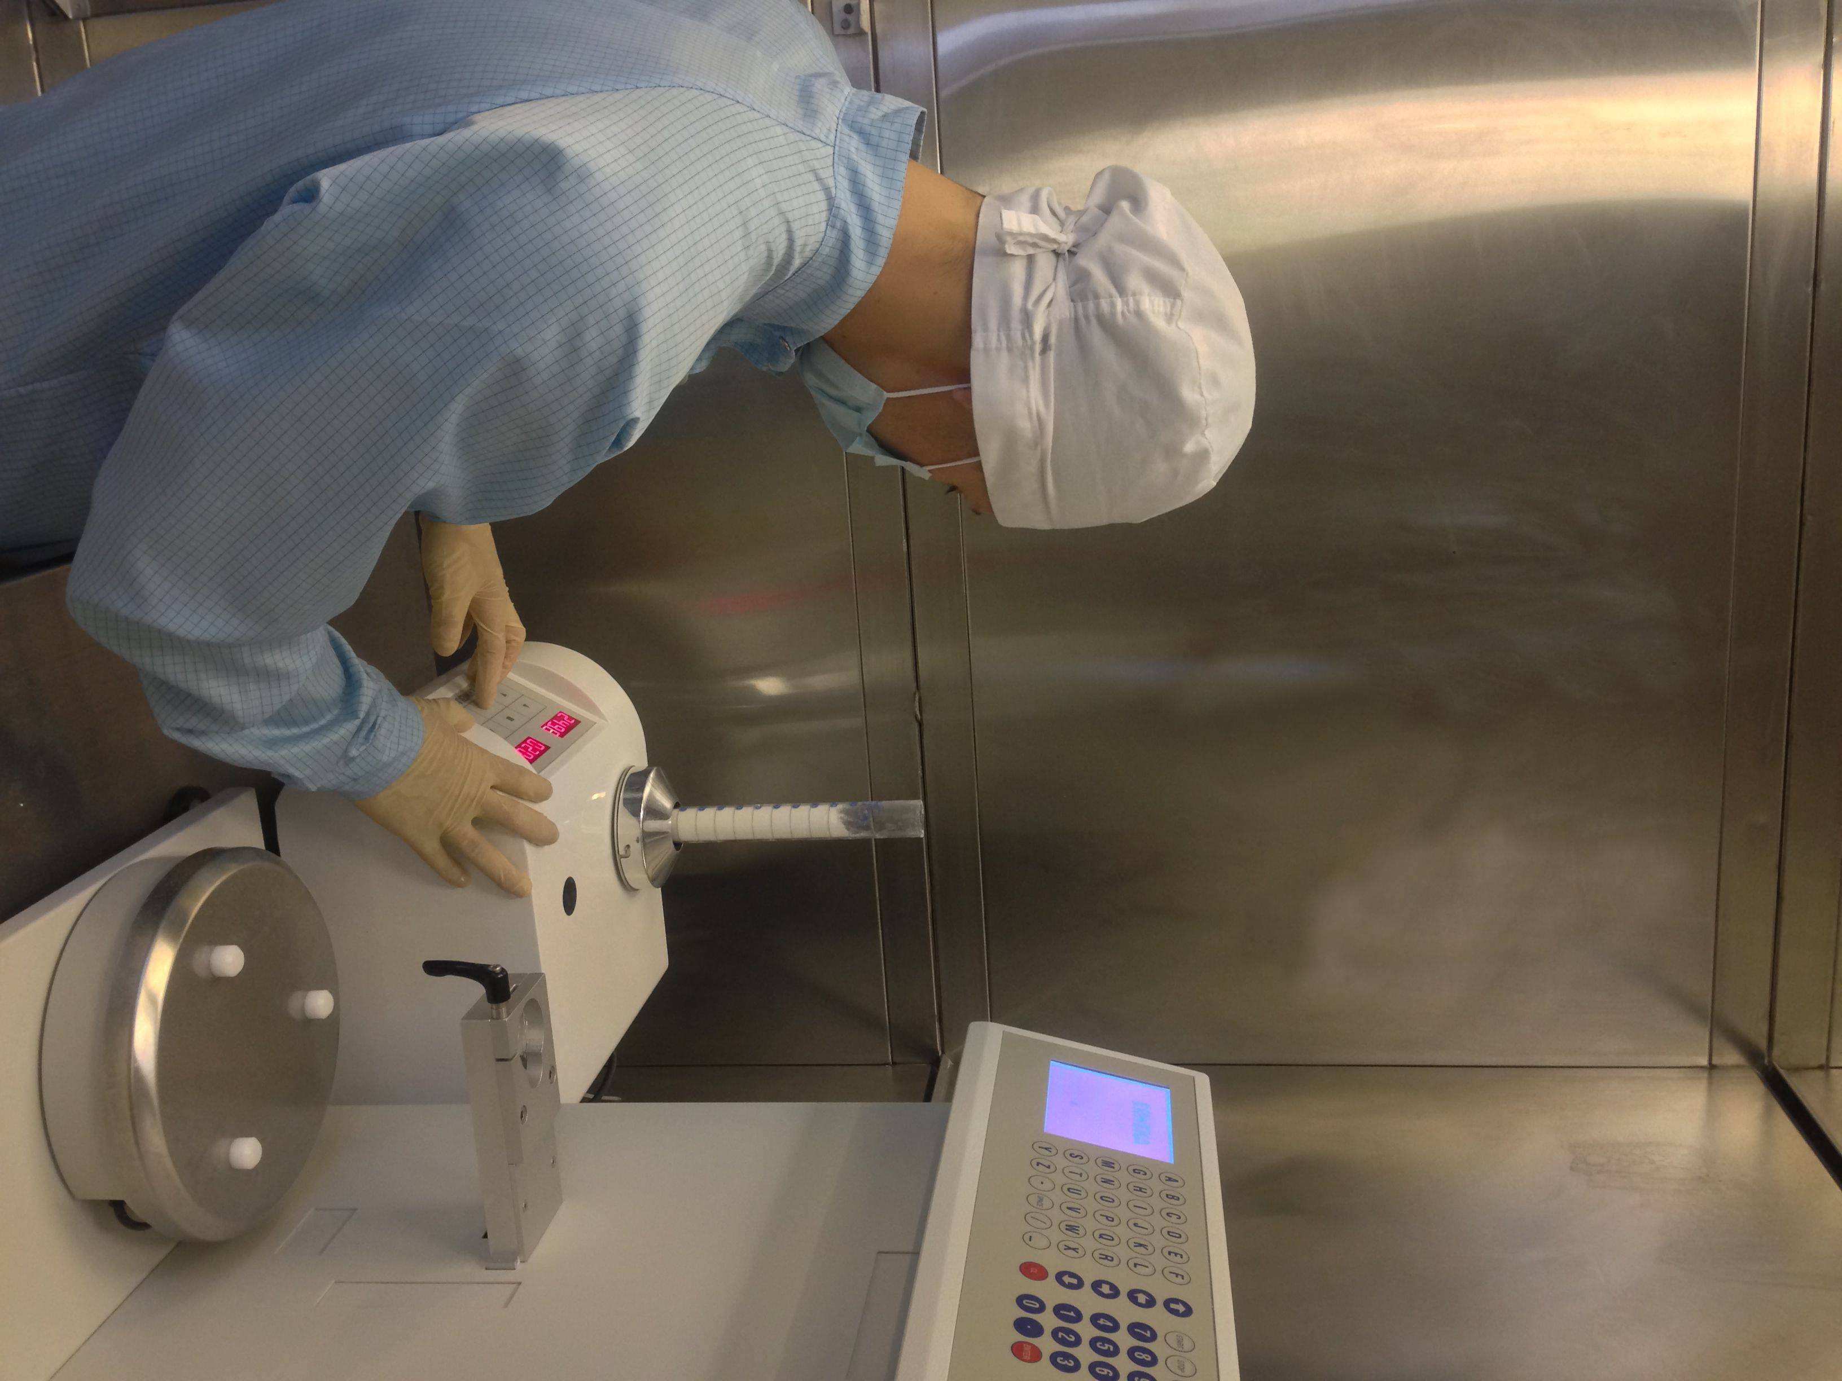
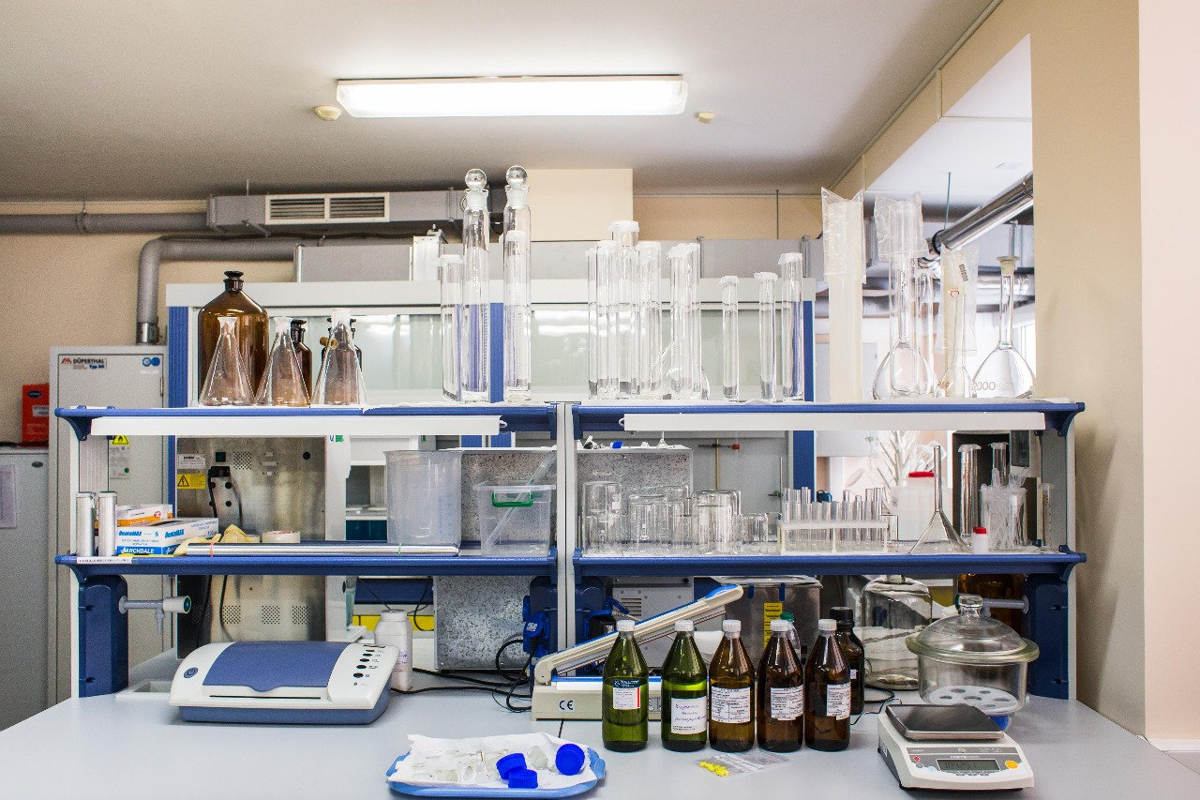
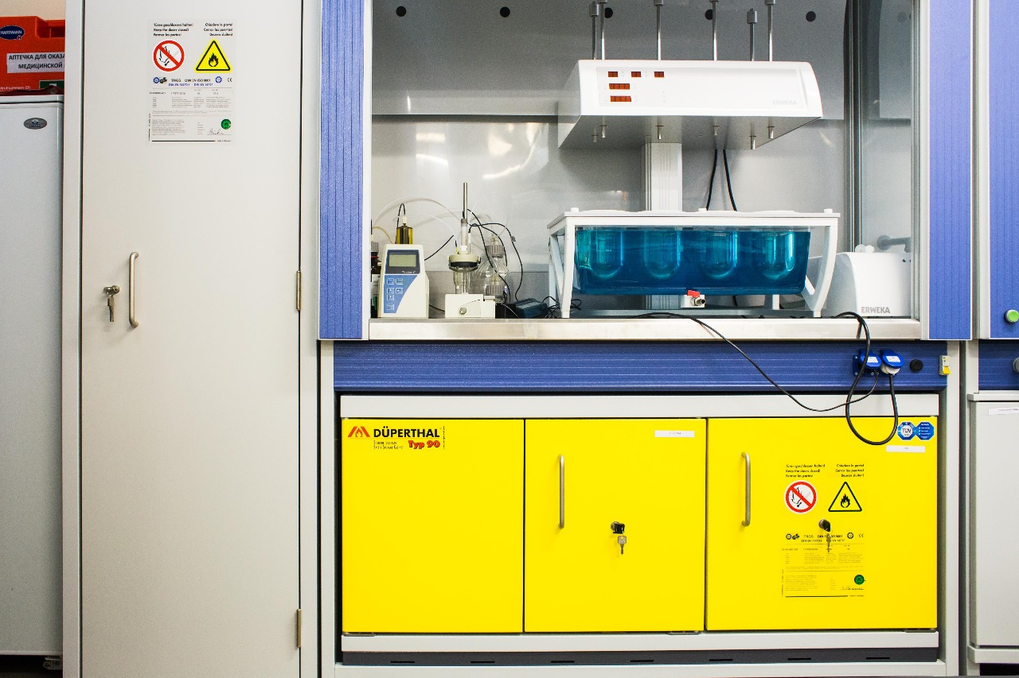
License, photos, links
Official site - https://aztpharma.ru/en/
Wiki about Phosphazide - https://ru.wikipedia.org/wiki/Фосфазид

Slide 11
THANK YOU FOR YOUR ATTENTION!
LLC AZT Pharma K.B.

